Slide 1
Distributed control for uniform circumnavigation of ring-coupled unicycles✩

Slide 2
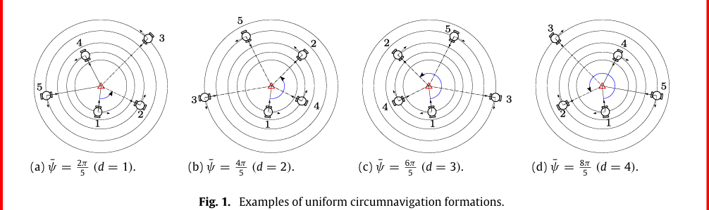

Slide 3
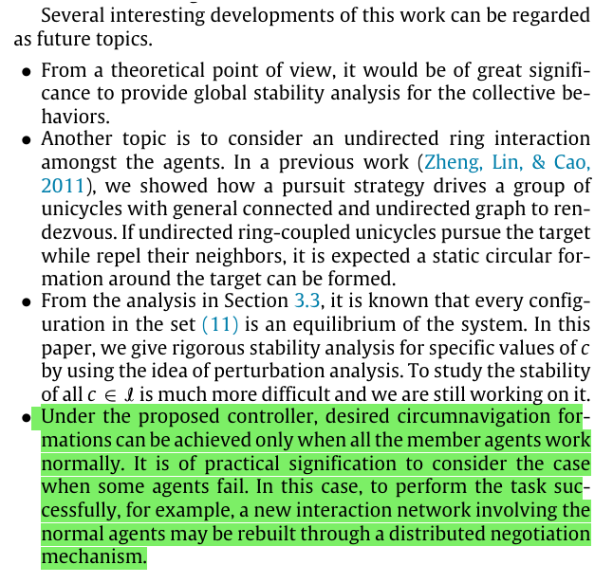
Future Scope
Notes:
1.Instead of proving stability only for certain equilibria or under small perturbations, one would want to show that all possible trajectories of the system converge to the desired collective behavior, regardless of initial conditions (within reasonable assumptions). 2.We’ve shown rendezvous with undirected graphs before. If we now combine undirected ring coupling with pursuit of the target and neighbor repulsion, we should get a stable circular formation. That’s an interesting extension to explore.

Slide 4
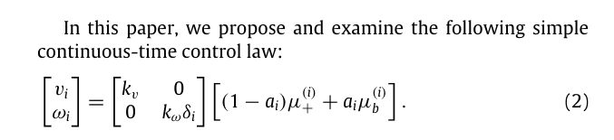
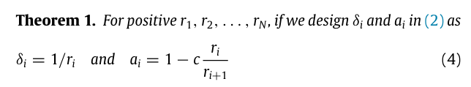
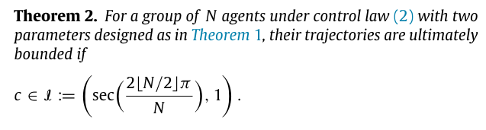
Controller synthesis and analysis
Controller synthesis-:
Boundedness analysis-:

Slide 5


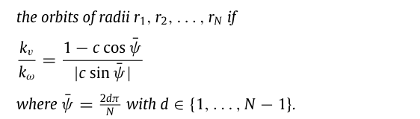
Equilibrium formations-:

Slide 6
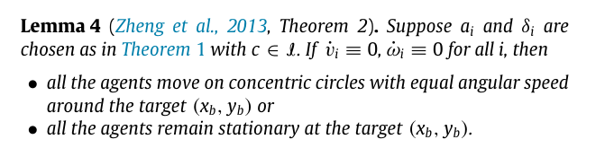
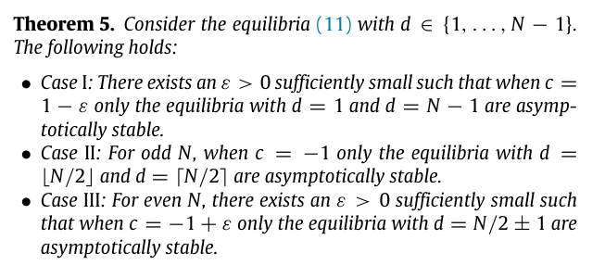
Stability Analysis-:

Slide 7
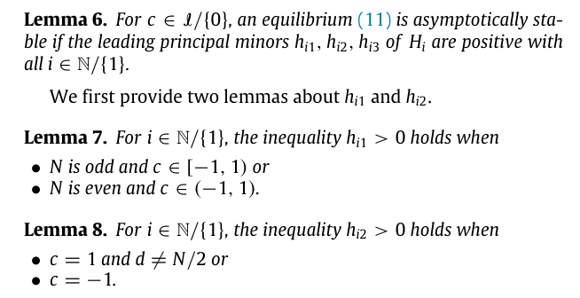

Slide 8
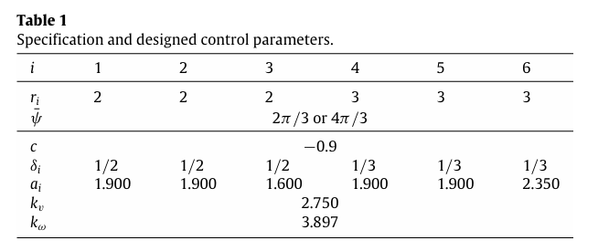
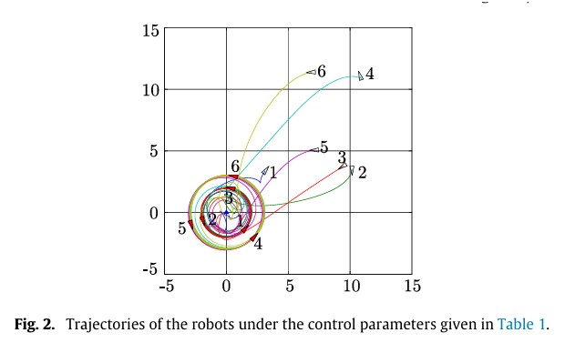
Simulations

